Slide 1


Machine Learning in Drug Discovery
Course : M2 Project Management for Production Processes
Presented by Ugur Ersöz
Ugur Ersöz

Slide 2


Why Drug Discovery Needs Innovation ?
Machine learning (ML) has the potential to make drug development processes faster and more cost-effective. Traditionally, bringing a new drug to market takes 10–15 years and costs approximately $2.6 billion.
Machine learning offers a transformative solution to these challenges
Frost & Sullivan, “Influence of Artificial Intelligence on Drug Discovery and Development,” July 18, 2018.
Ugur Ersöz

Slide 3
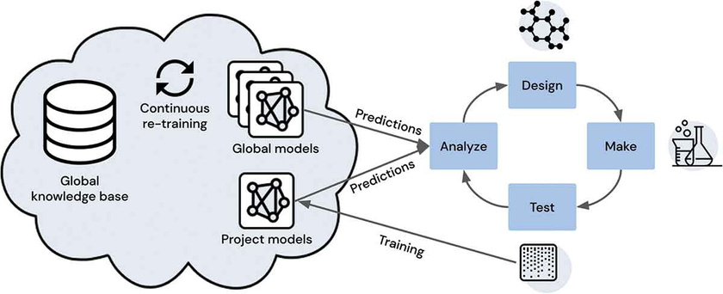
What is machine learning?
Machine learning is like a basketball coach, guiding computers to learn from data and make smart moves. Just as a coach analyzes players to devise the best game strategy, machine learning identifies patterns and predicts future possibilities.
Off the court, this technology takes the spotlight in fields like drug discovery, delivering game-changing solutions in the fight against diseases.
Ola Spjuth, Jens Frid & Andreas Hellander
https://doi.org/10.1080/17460441.2021.1932812
Ugur Ersöz

Slide 4
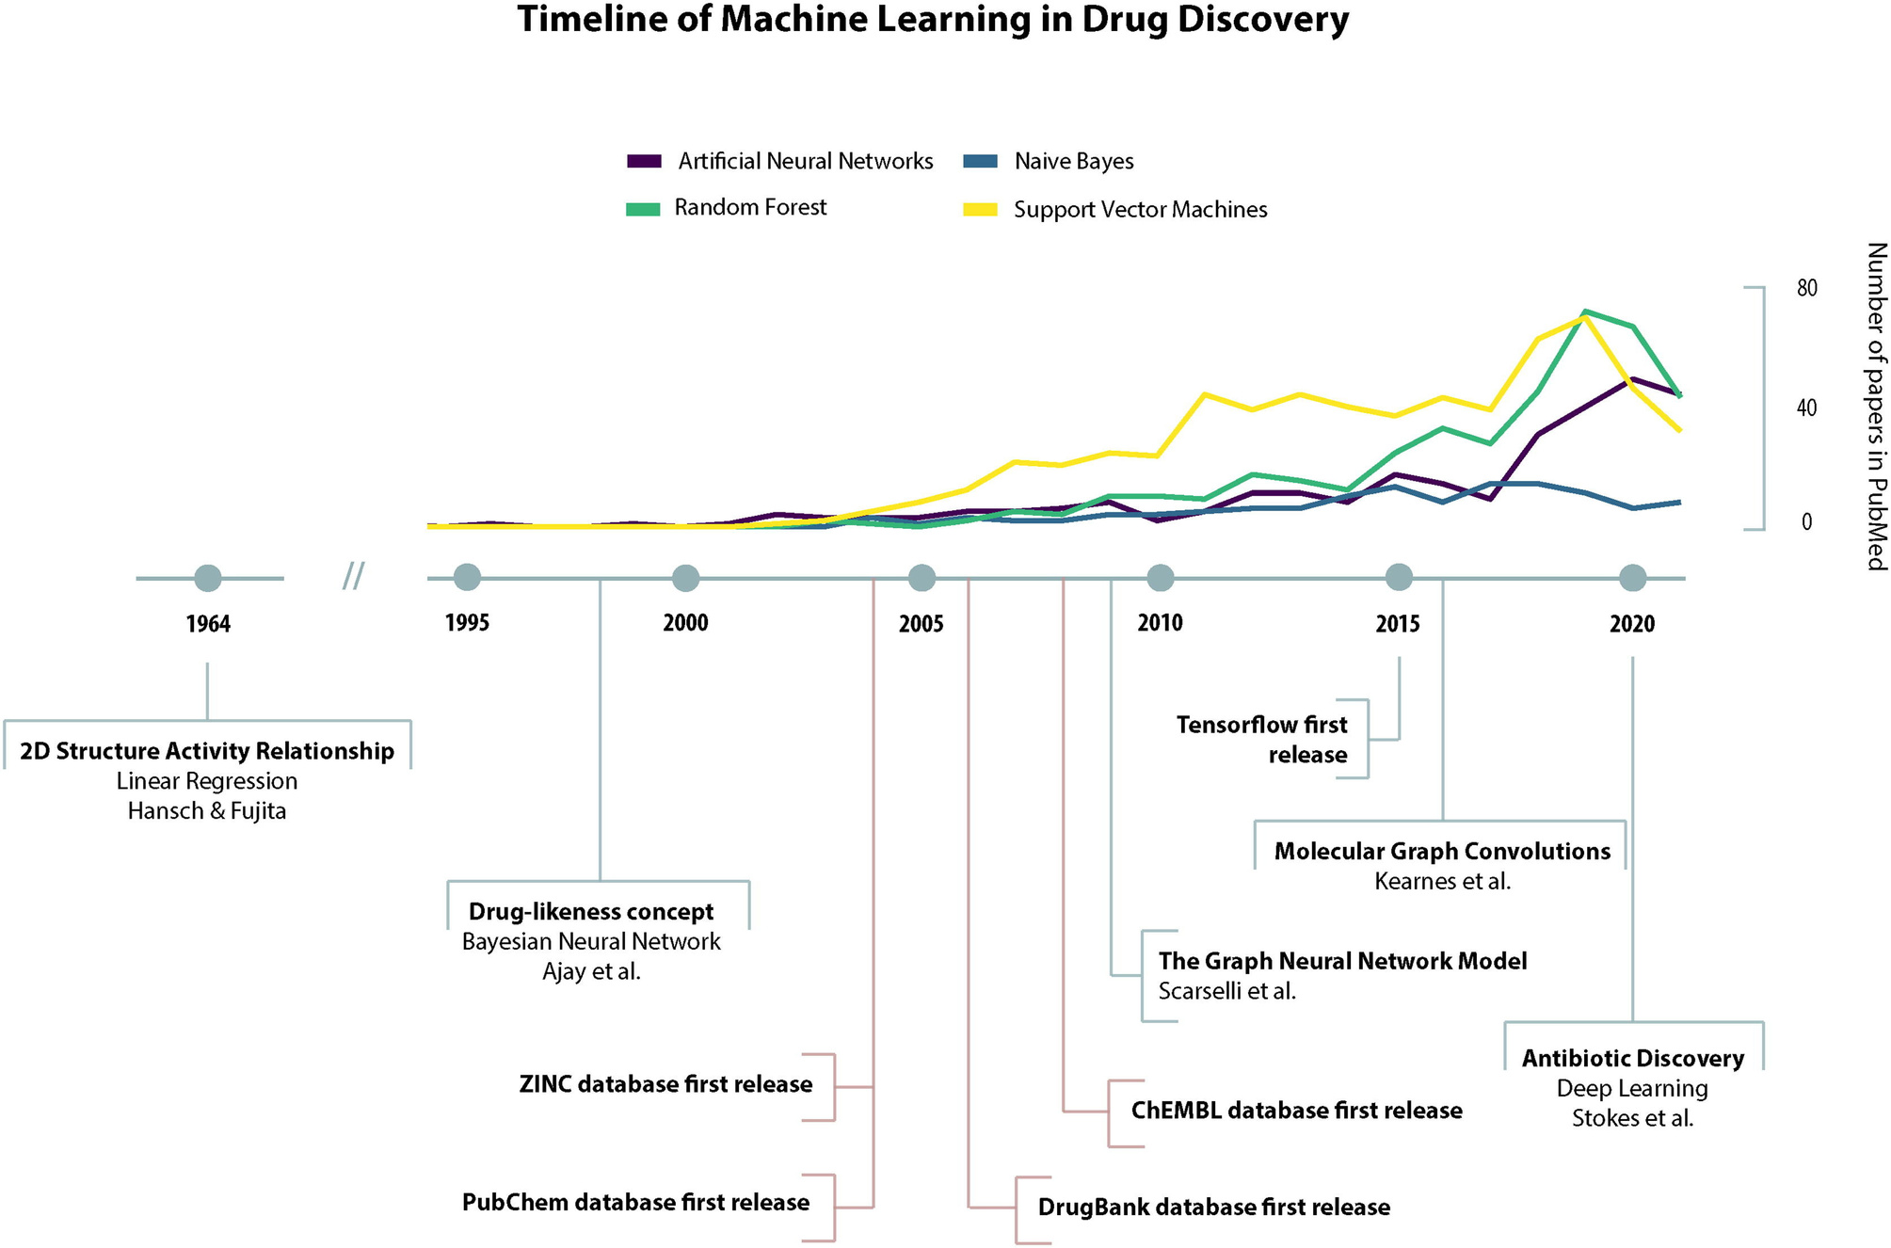
Carracedo-Reboredo, Paula et al.
Computational and Structural Biotechnology Journal, Volume 19, 4538 - 4558
Ugur Ersöz

Slide 5
The Role of Machine Learning in Drug Production System
1
2
Drug Discovery
Speeds up the identification of new drug candidates, modeling of protein structures, and toxicity assessments
Preclinical Studies
Enhances the analysis of molecular targets and the optimization of compounds
Clinical Trials
Post-Approval Monitoring
Automates the evaluation of drug safety and effectiveness
3
4
Improves the efficiency of trial design and data analysis
Ugur Ersöz

Slide 6
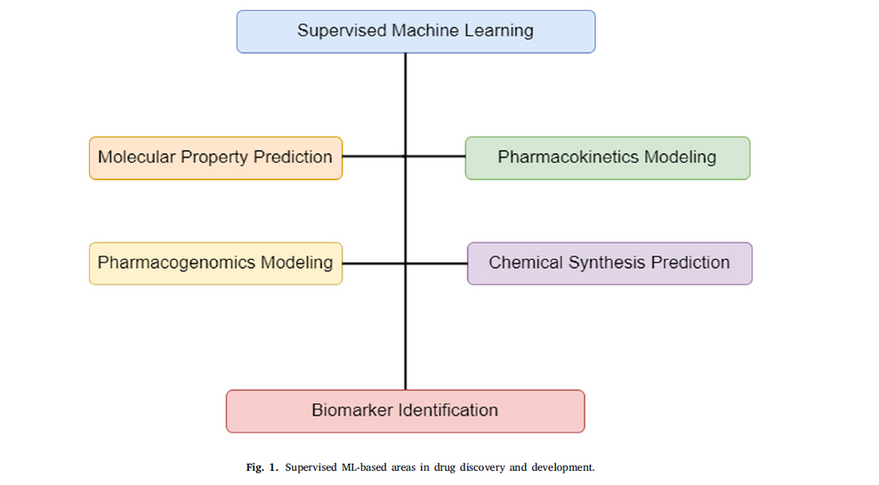
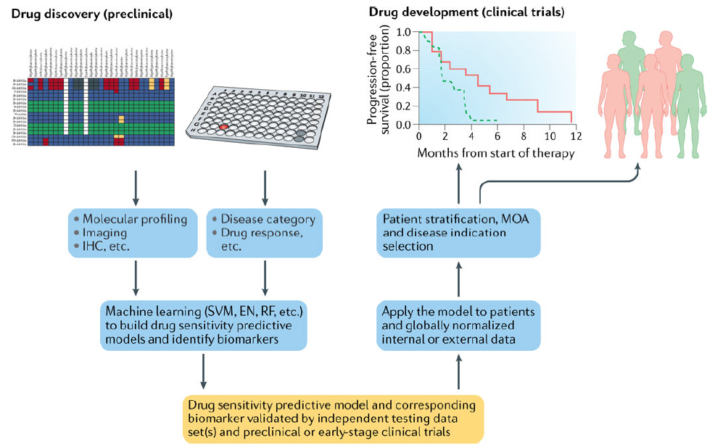
Obaido, G., Mienye, I. D., Egbelowo, O. F., Emmanuel, I. D., Ogunleye, A., Ogbuokiri, B., Mienye, P., & Aruleba, K. (2024). Supervised machine learning in drug discovery and development: Algorithms, applications, challenges, and prospects. Journal of Advanced Research in Computer Science, 10(2), 123–145. https://doi.org/10.1016/j.jacr.2024.01.052
From Preclinical to Clinical Stages with Machine Learning
Vamathevan, J., Clark, D., Czodrowski, P., Dunham, I., Ferran, E., Lee, G., Li, B., Madabhushi, A., Shah, P., Spitzer, M., & Zhao, S. (2019). Applications of machine learning in drug discovery and development. Nature Reviews Drug Discovery, 18(6), 463–477. https://doi.org/10.1038/s41573-019-0024-5
Ugur Ersöz

Slide 7

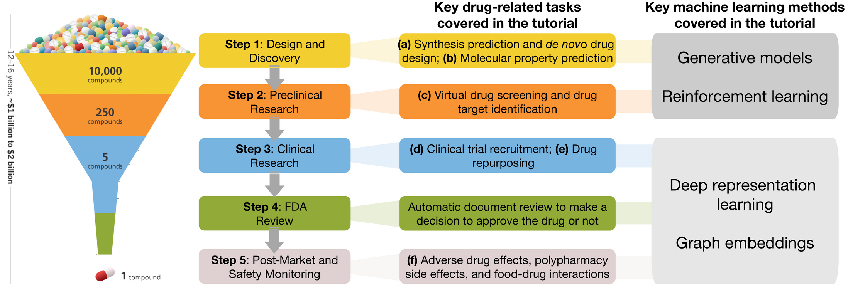
Machine learning plays a pivotal role in the drug development process, particularly in the "Drug Discovery" and "Preclinical" stages, by accelerating critical tasks such as identifying new drug candidates, predicting protein structures, and analyzing toxicity.
Additionally, it supports data analysis and optimization throughout the entire process, from clinical trials to post-approval monitoring, offering significant time and cost savings.
https://zitniklab.hms.harvard.edu/drugml/
Ugur Ersöz

Slide 8
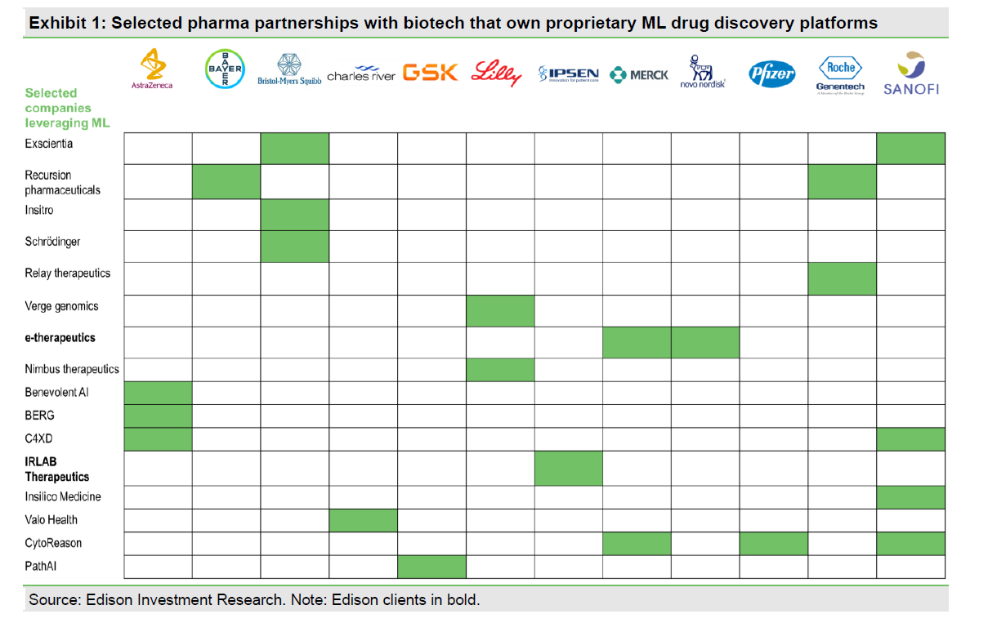
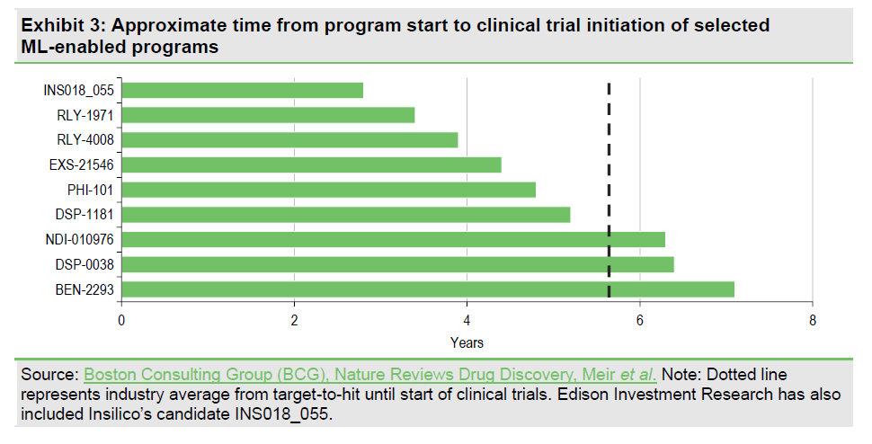
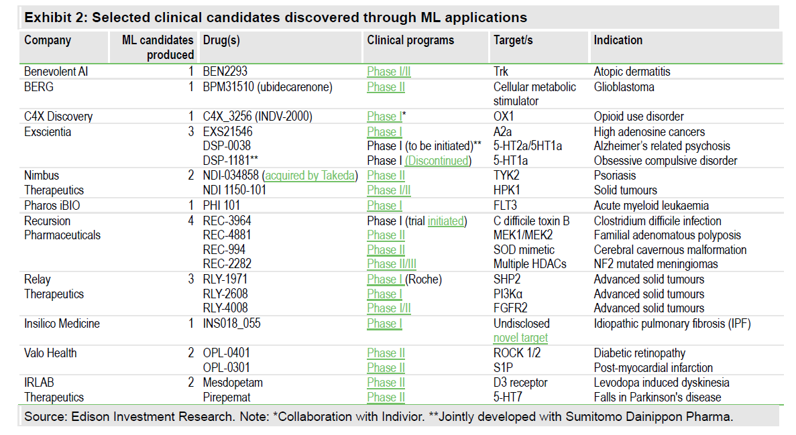
Speed and Collaboration
https://www.edisongroup.com/thematic/machine-learning-in-drug-development/33143/e/
Ugur Ersöz

Slide 9
Major Challenges
Data Quality and Accessibility
Reliable, high-quality, and accessible datasets are essential for training effective ML models, yet clinical and preclinical data often face issues with completeness and reliability
Bias and Representation Issues
Imbalanced or poorly representative training data can introduce bias, leading to inaccurate predictions, especially for underrepresented patient groups
Complexity of Human Biology
ML struggles to fully model the intricacies of human biology, as current preclinical models (e.g., animal studies) do not always translate well to human physiology
Ugur Ersöz

Slide 10

Future
Key Takeaways
High-quality datasets: The success of machine learning (ML) algorithms in drug development depends heavily on the availability of high-quality, large-scale datasets.
Feature selection: Processes like feature selection are critical for converting raw data into meaningful inputs for ML models.
System reliability: Proper data preparation and feature selection enhance the reliability and reproducibility of ML systems.
Efficiency and personalization: Integrating ML into drug development improves production efficiency and enables the creation of more effective, personalized treatments.
Ugur Ersöz

Slide 11



presentation page & references 👇
Ugur Ersöz

